Slide 1
UWB Sustainability Website

Slide 2
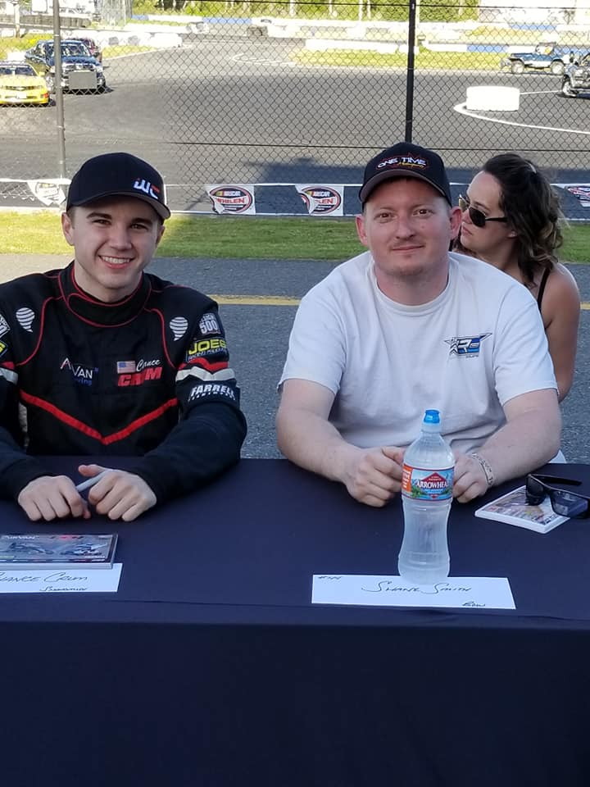
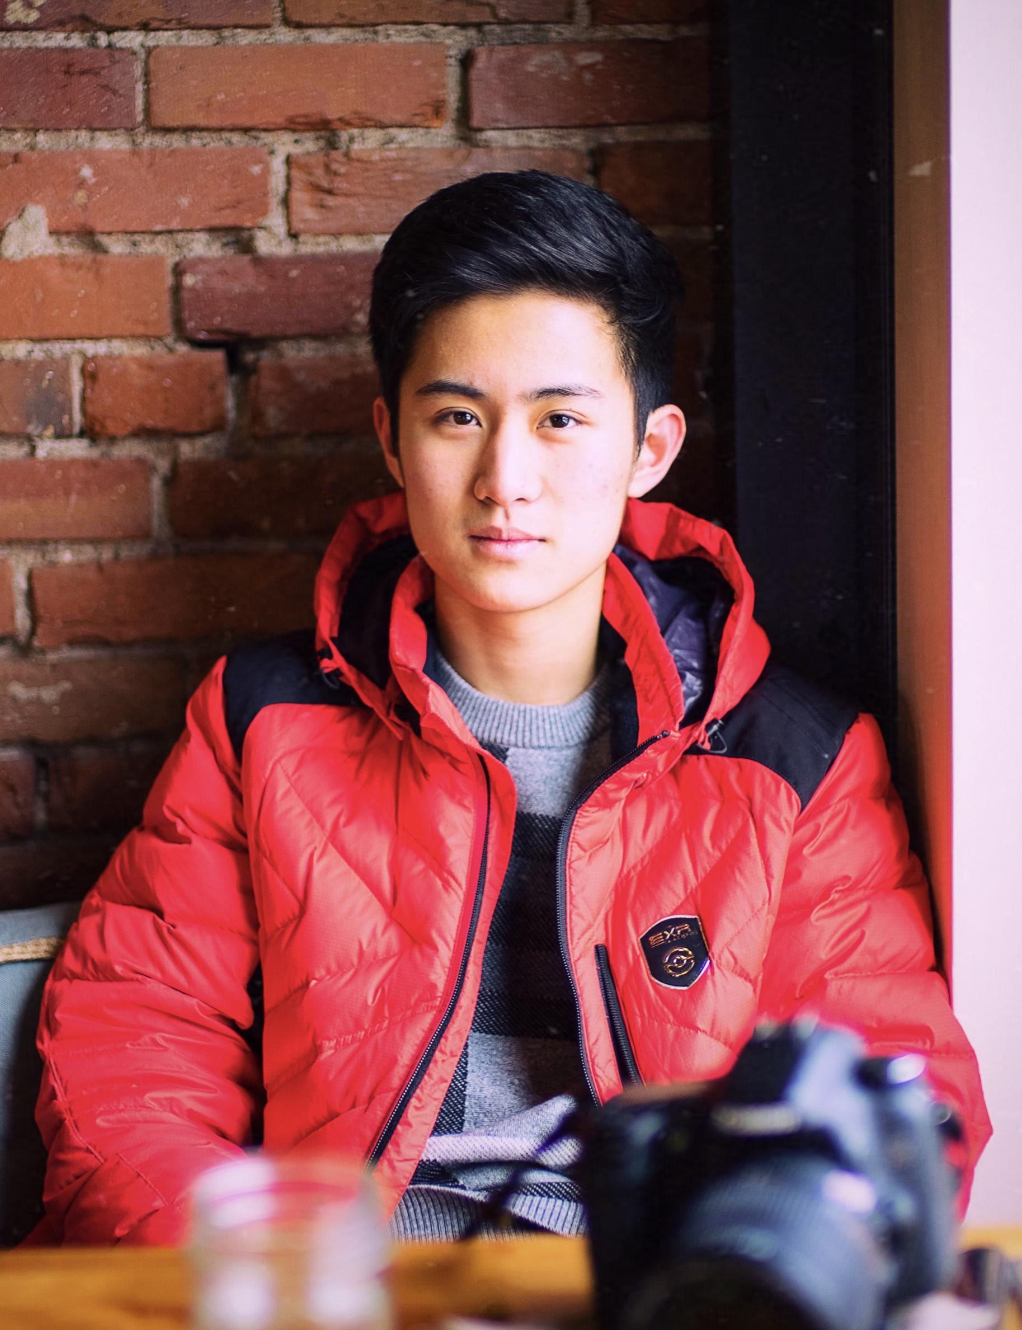
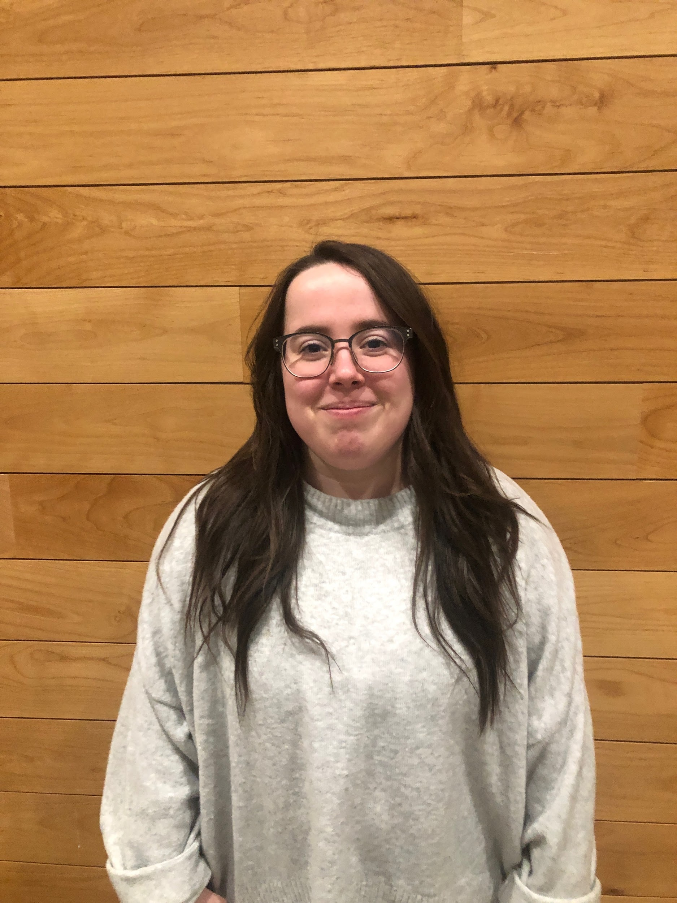
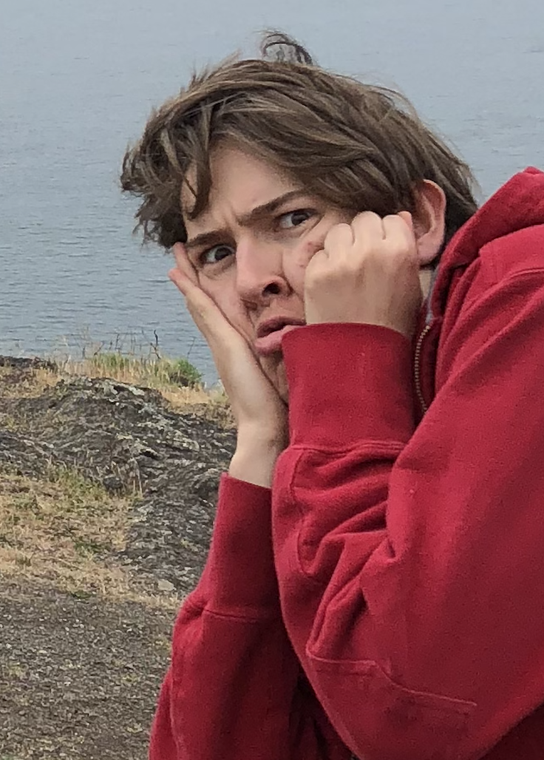
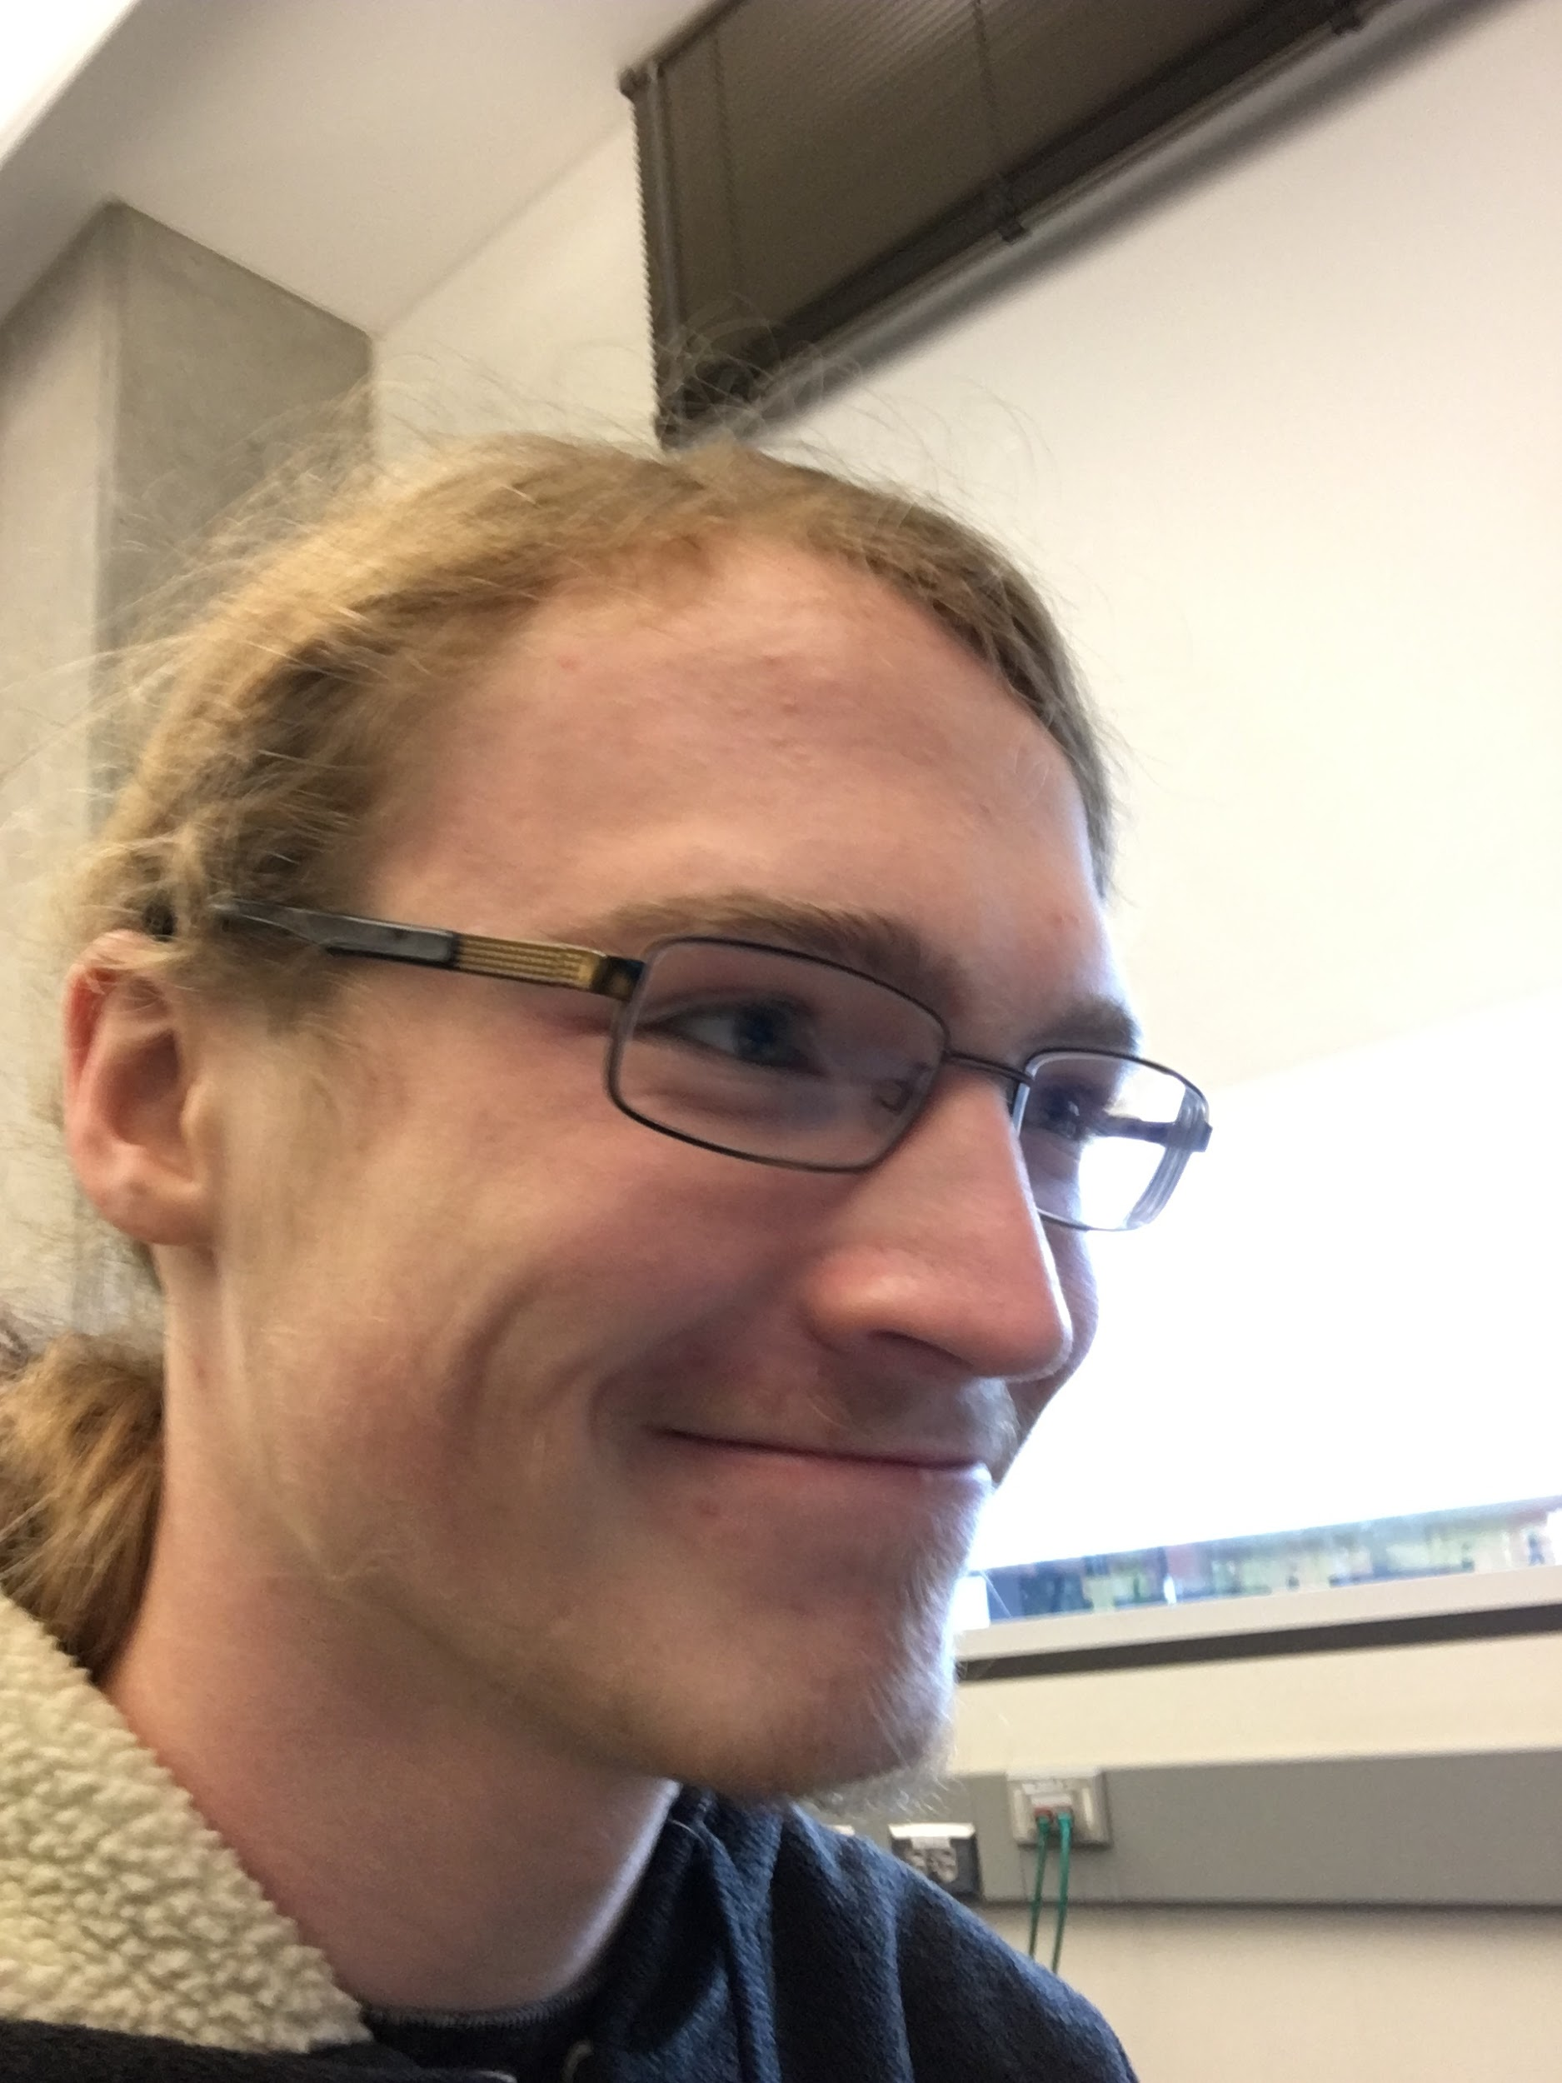
Our Team
Chance Crum Yuyu Dai Hannah Ferry Garrett Kuroiwa David Hudson

Slide 3
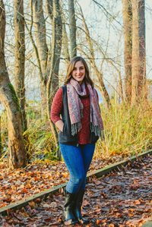
Community Partner
Alexa Russo
Sustainability Coordinator at UWB

Slide 4
Our Goal
Improve usability of the
UW Bothell Sustainability Site

Slide 5
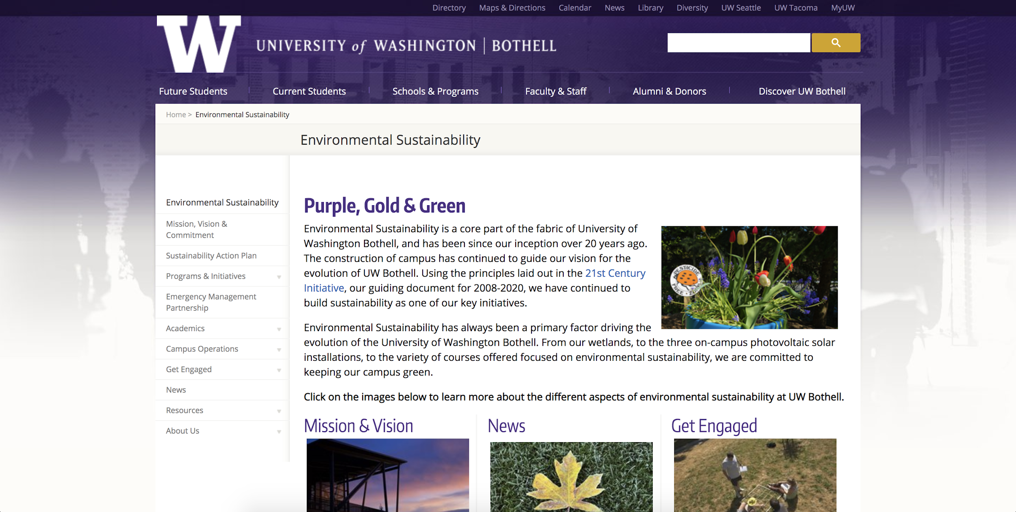

Slide 6
Research Methods
“What is the public perception of Sustainability on campus? How are people interacting with the existing site/resources?”

Slide 7
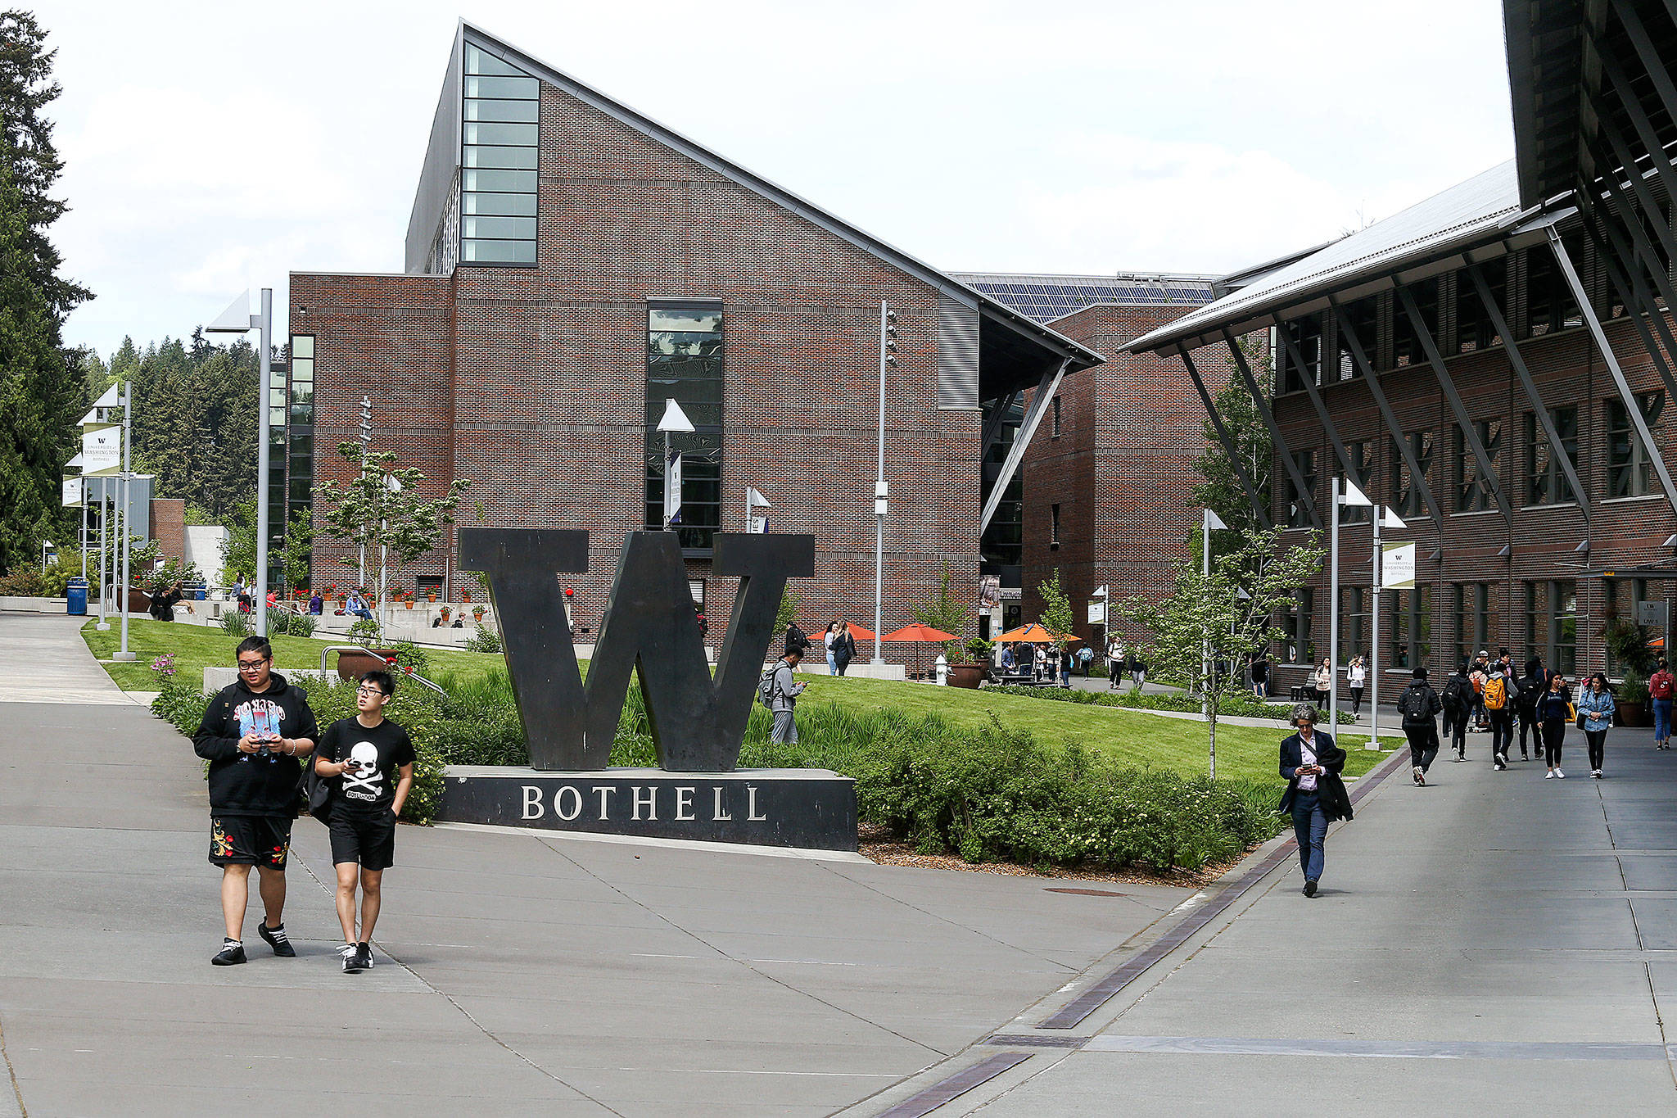
Site Visits
UW Bothell campus
Interviewed students on sustainability knowledge
Website visits
Watched how people navigated the website

Slide 8
Types of Data Collected
Interviews: 11
Procured during our site visits
Surveys: 14
Sent to students we knew and posted on social media
Walkthroughs: 5
Monitored people navigating the existing website
Analytics: 18 pages
Website use information

Slide 9
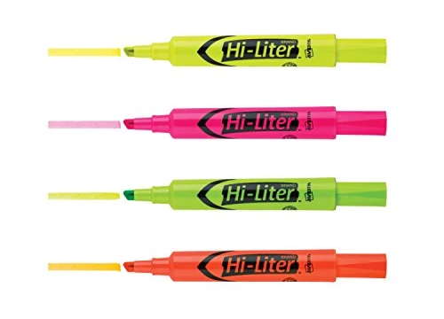
Data Coding
Data We Coded
Interviews
Fill-in-the-blank survey questions
Website walkthroughs
Categorized common themes in data

Slide 10
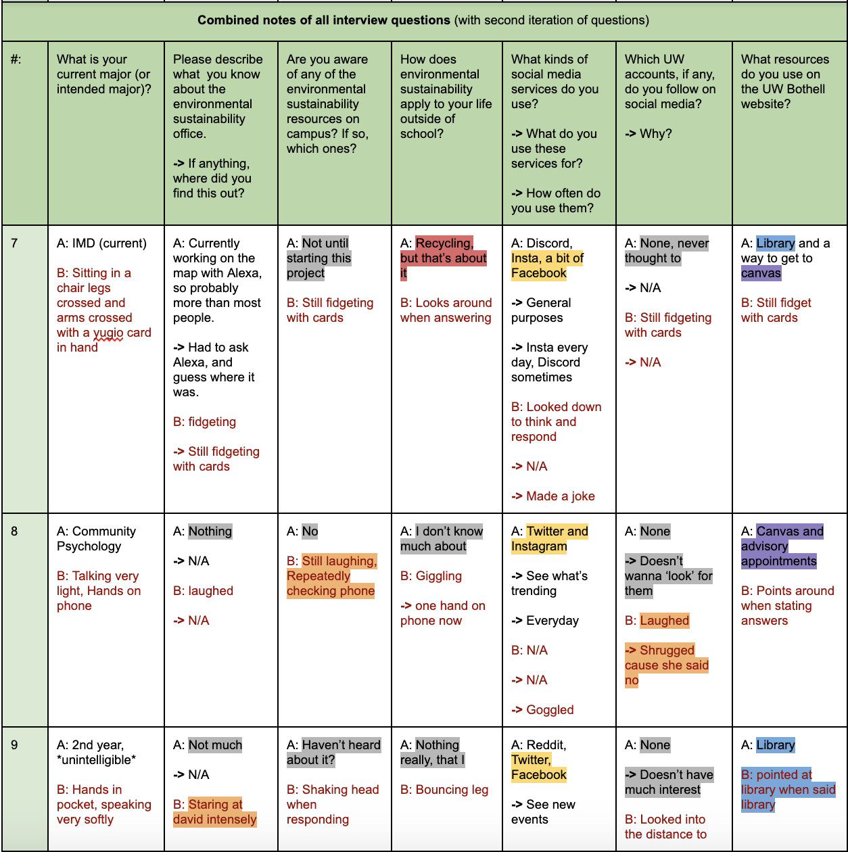

Slide 11
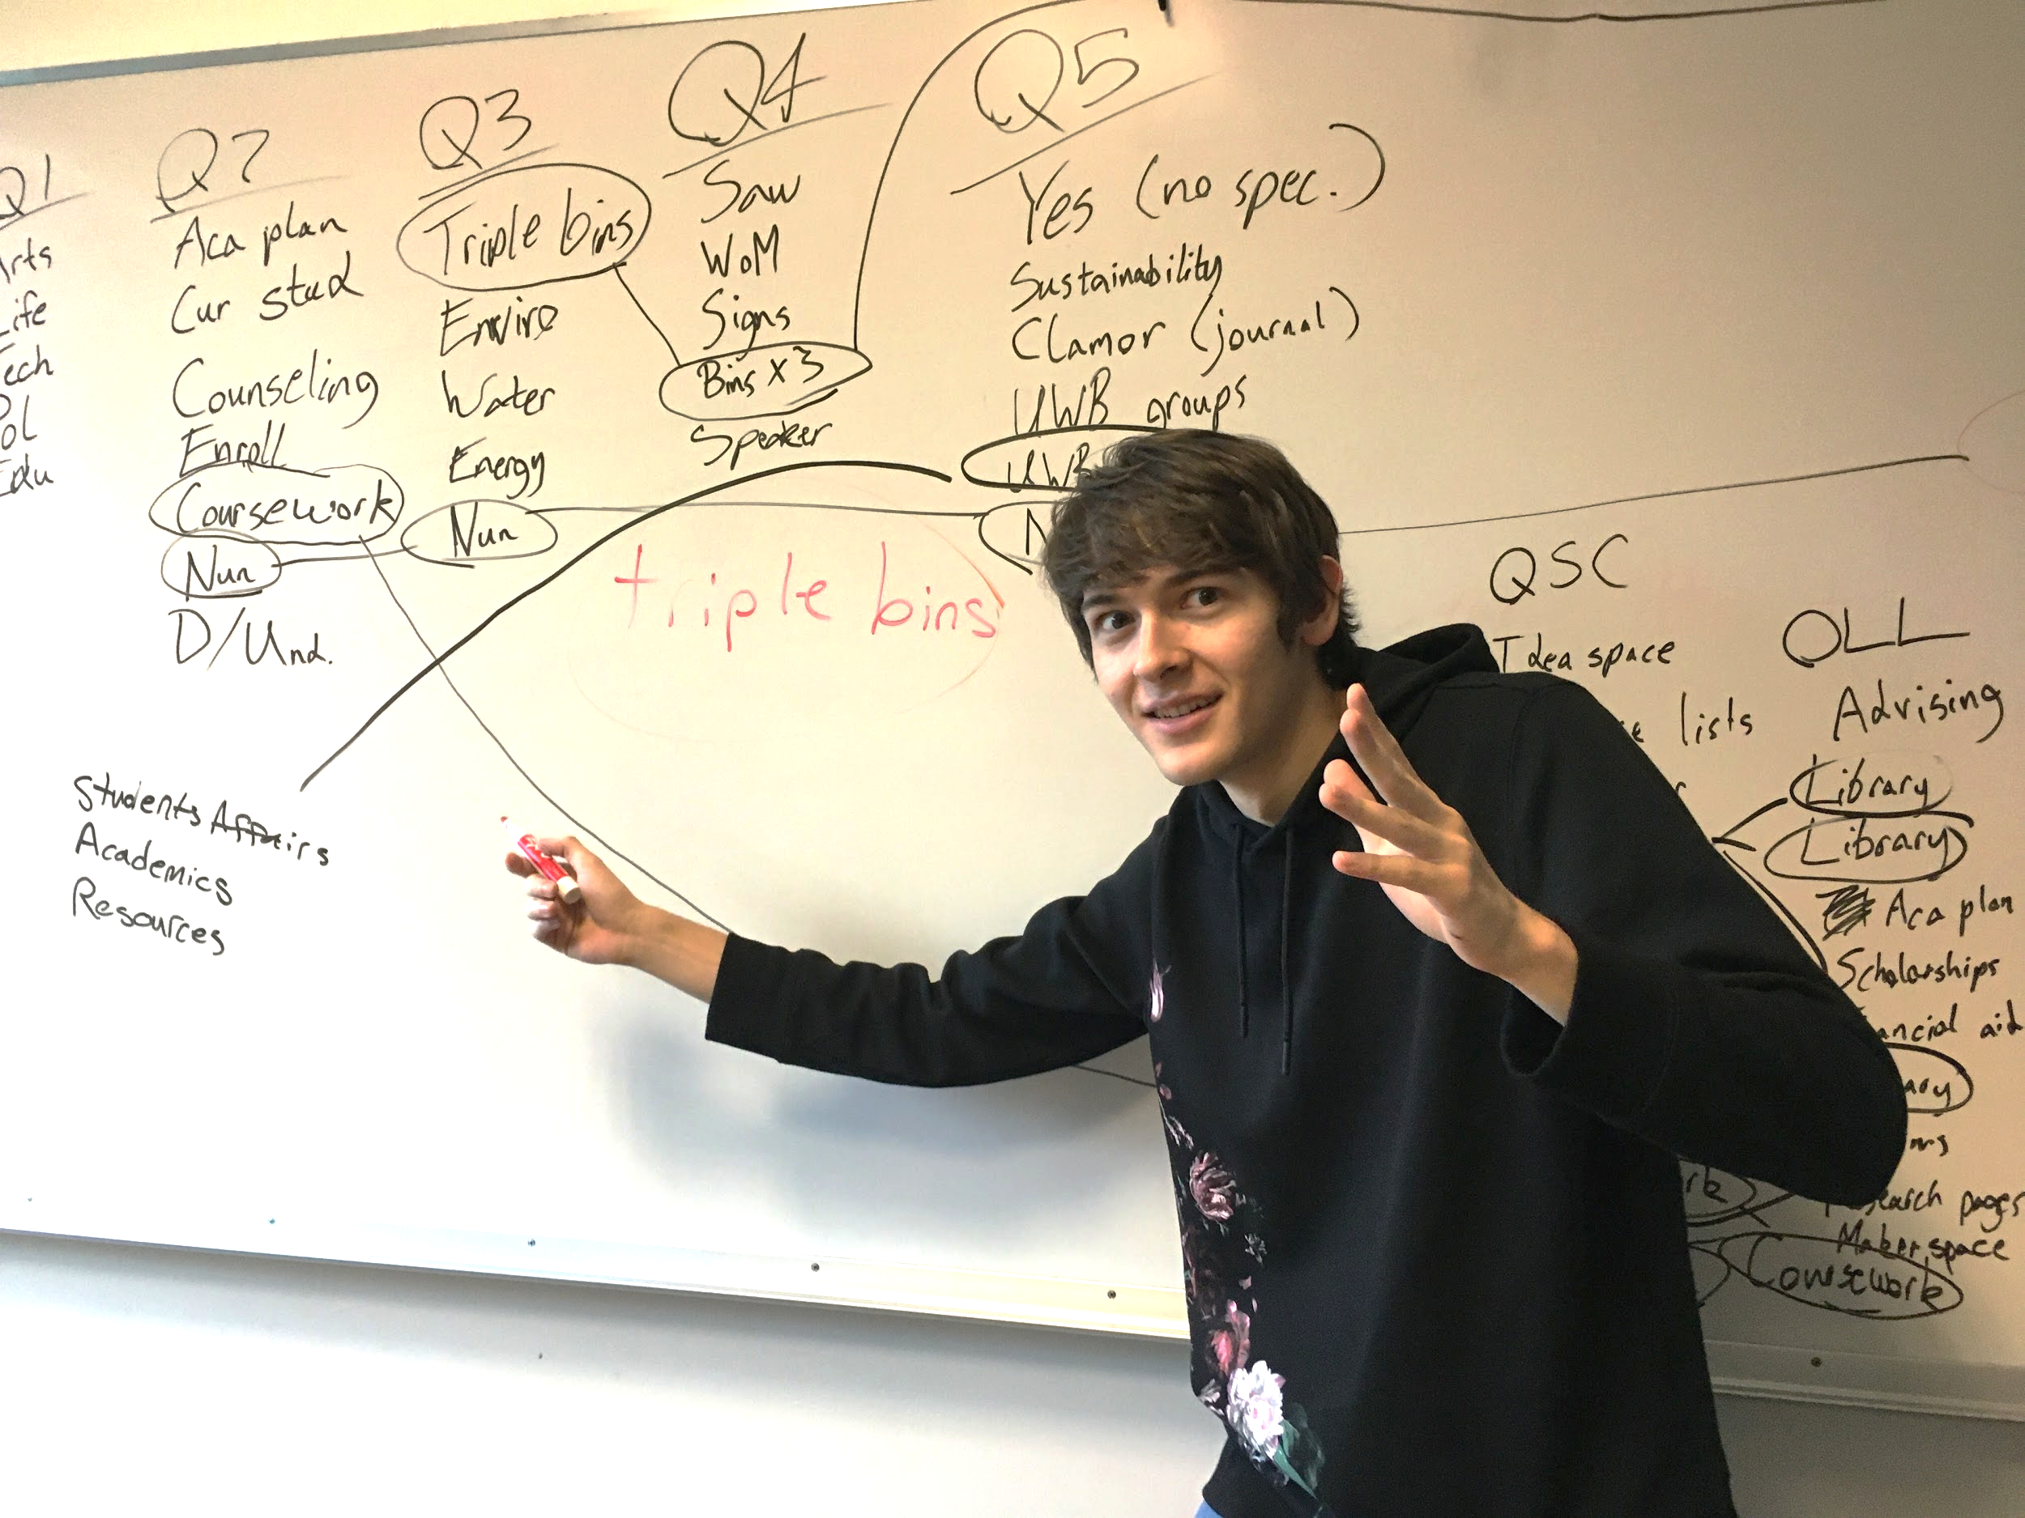
Final Coding Scheme: Interviews/Surveys
Waste Disposal: 20 .
Uncomfortability: 8 .
Informal/”Casual” Social Media: 12 .
Student Affairs: 17 .
Academics: 18 .
Library: 6 .
Disconnection: 33 .

Slide 12
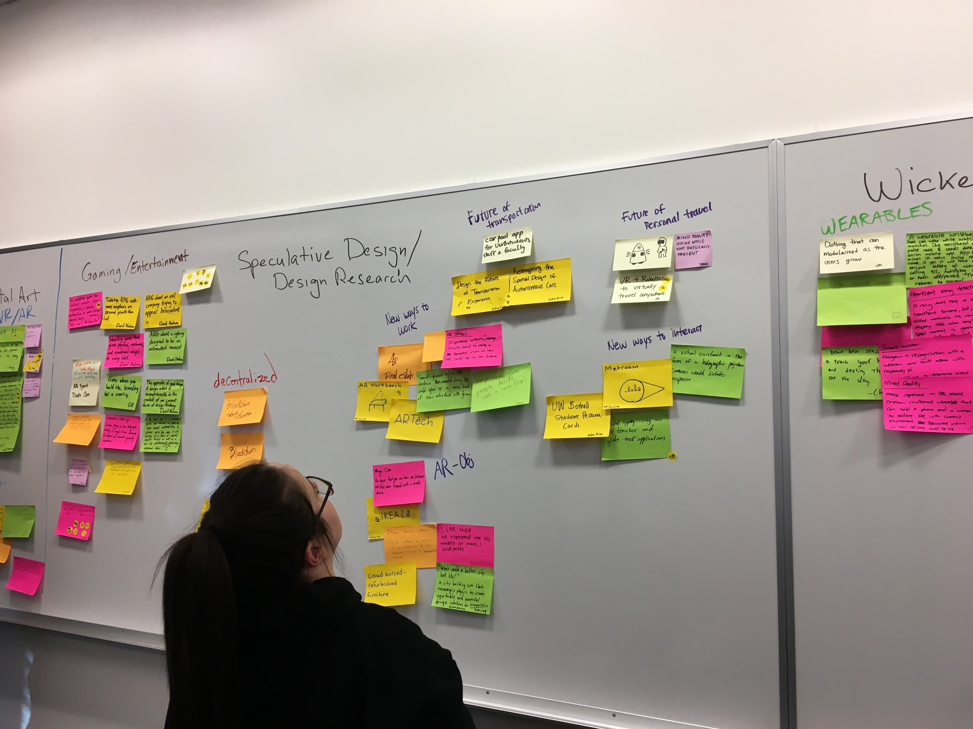
Final Coding Scheme: Website Walkthroughs
Correct Page. 39 .
Read Out Loud. 22 .
Confusion. 16 .
Wrong Page. 10 .
Looking Around. 15 .
Other Feedback. 7 .
Map/Image. 2 .
Earth Week. 4 .
Excited. 1 .

Slide 13
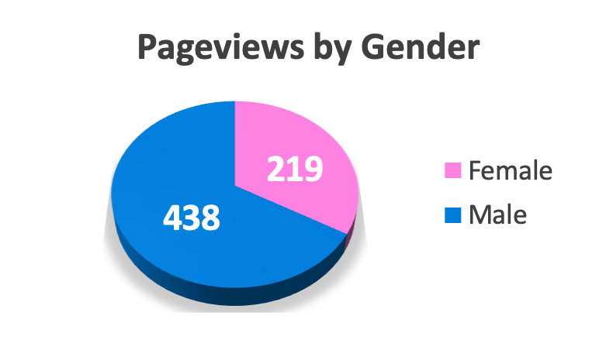
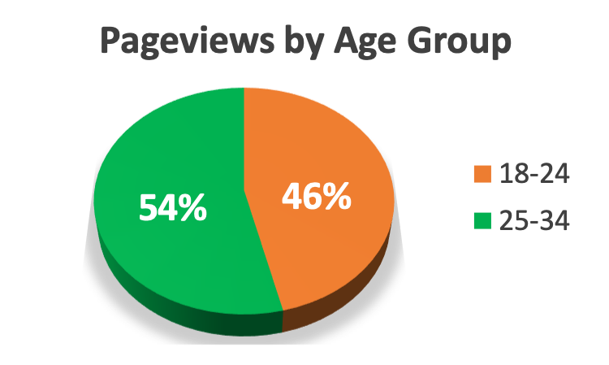
Data Analytics - (10/30/17 - 11/5/2019)
Top 10 Pages Visited
sustainability
sustainability/programs-initiatives/campus-garden
sustainability/campus-operations/grounds
sustainability/about-us
sustainability/campus-operations/food
sustainability/academics/degrees
sustainability/mission-vision-commitment
sustainability/campus-operations
sustainability/programs-initiatives/earth-week
sustainability/sustainability-action-plan

Slide 14
Our Findings
What are we looking at?

Slide 15
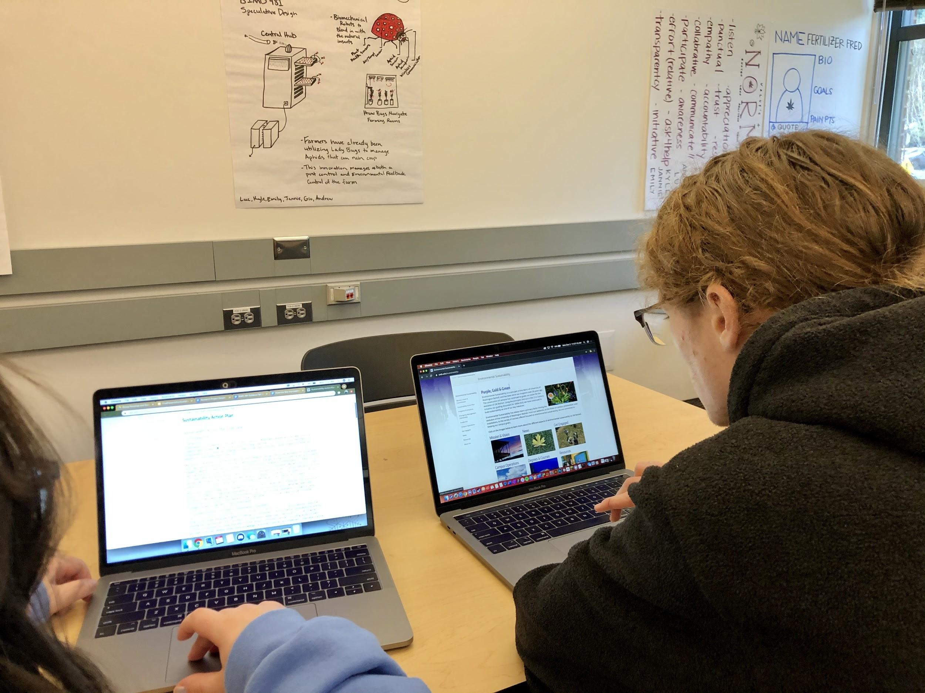
What We Found
Lack of familiarity with Sustainability Office
Knowledge of sustainability is limited to environmental
Similar information on different pages of website
Smaller low-level issues

Slide 16
Personas and Scenarios
Who are our users?

Slide 17





Potential Payton
Demographics
Age 20
Occupation Barista at Common Grounds/Student
Status Single
Location Lynnwood, WA
About
Payton is a junior UWB student with a Business major and a minor in Computer Science. Payton commutes to campus by bus, not necessarily for sustainability reasons. They’ve heard of the word “sustainability” before, but don’t know much about it. Payton thinks caring about the environment is important, but doesn’t know how to connect that with their work and busy schedule.
Goals
Excel in studies
Support “common good”, without compromising self
Graduate and get a job to help pay off college debt
Personality
Dislikes
Seeing waste on the ground
Wasting money
Introvert
Extrovert
Sensing
Intuition
Technology Usage
Thinking
Feeling
Low
High
“When recycling a water bottle does the cap stay on it or off it?”
Payton
Judging
Perceiving
Low
High
Clubs/Hobbies
FMA (Financial Management Association)
Scrolling through Twitter on their downtime
Low
High
Low
High

Slide 18
Potential Payton - Scenario
Payton is studying for one of her business classes in the campus library. She finishes drinking her bottle of water, and goes to the bins to throw it away. Before she recycles it, she remembers hearing before that the cap and the bottle are supposed to go into different bins. Unsure of what to do, she just puts both into the recycle and moves on. Later that day Payton passes by the bins to throw away the wrapper from her sandwich, and finds herself being uncertain, yet again, of what to do. She wonders if the scraps of food left on it are able to be recycled or if they need to be composted. Without knowledge of the proper distinction, she just recycles it. She’s afraid she may have made the wrong decision though, and starts to feel a little guilty about it.
Wanting to know more about the proper way to dispose of waste, she searches for ‘UWB trash cans’ on her laptop when she gets back to class. The first link on Google that comes up is to Waste - Environmental Sustainability - UW Bothell. This reminds her of when she heard the word sustainability before, a couple years before in one of her classes. Interested in learning more, Payton opens the website and begins to read about the trash cans on campus. She notices there is a lot of information presented on this UWB Sustainability website. There’s lots of subheaders on the left of the page, and so out of curiosity she begins to explore them.
Impressed by the amount of sustainability info that UWB has to offer, Payton feels a sense of pride towards her school. Without realizing it, she has now moved on from learning about the trash cans without answering her initial question yet. The next subheader beneath Waste is MiniMax, so she clicks that one. A page of descriptions and FAQ’s about MiniMax comes up. Payton skims the whole thing, but still has no idea what MiniMax bins are. She spots two clickable links for landfill and recycling sorting guides. Excited to finally find an answer to her question, she right clicks them and opens them in new tabs. Both are dead links. Disappointed but not willing to give up yet, Payton looks back at the navigation sidebar. The main header says “Environmental Sustainability”. She clicks on it hoping to learn what ”sustainability” is. She scans the paragraph but can’t find any definitions for sustainability, other than that it is something that the UWB and Cascadia campuses practice. Disappointed again, Payton closes the tab and goes on about her day.

Slide 19

Searching Sam
Demographics
Age 21
Occupation Volunteers/Student
Status Single
Location Bothell,, WA
About
Sam is a senior UWB student who is majoring in Biology. Sam carpools with their roomates to campus. Some of their friends are members of the UW Bothell Sustainability Club. They haven’t joined it themselves, but Sam tries to live a sustainable lifestyle. Sam knows that resources related to sustainability exist, but hasn’t connected with them before.
Goals
Connect sustainability to their work and major
Live a sustainable lifestyle
Graduate and get a job who’s core values matches theirs
Personality
Dislikes
When people don’t know how to sort their trash
Apathy towards public good or the environment
Introvert
Extrovert
Sensing
Intuition
Technology Usage
Thinking
Feeling
Low
High
“I care about sustainability. How do I get involved on campus?”
Sam
Judging
Perceiving
Low
High
Clubs/Hobbies
Volunteers when time allows
Uses the food garden to collect herbs
Low
High
Low
High

Slide 20
Searching Sam - Scenario
Sam generally tries to live a sustainable lifestyle outside of his education at UWB, but finds himself struggling to find ways to make it work. He’d like to learn some skills related to sustainability, but he doesn’t know where to look. He remembers that sustainability resources exist on campus, and decides to look on the website.
He types “uwb sustainability” into Google. He clicks on the first result: “Environmental Sustainability - UW Bothell”. This takes him to the UWB sustainability webpage. He’d like to see what the office’s ideals are and if they align with his own, so he clicks on the “Mission, Vision, and Commitment” link on the sidebar. He finds the statement a little long for a general mission statement, but sees that he and the office are on the same page.
Sam wants to know how he can get involved on campus now, so he scans down the sidebar. He assumes that “Programs and Initiatives” will have programs that he can get involved in, so he clicks on it. He looks over the page and sees the page called “Earth Week.” Excited to find a campus event about sustainability, he clicks on it. He is interested in the various activities listed until he gets a few paragraphs in and sees that it is referring to Earth Week 2019. Disappointed, he goes back to the “Programs and Initiatives” page.
On that page he sees a picture link labelled “Campus Farm.” This sounds perfect to him. It could teach him how to farm, which is a skill he could put to use outside of school to make his lifestyle more sustainable. He clicks on the page and sees the header saying “Get Involved.” He sees that the best ways to get involved are to contact Alexa Russo at the provided email address, follow the farm’s Facebook page, and sign up for its mailing list. Sam does all three.
Sam now has a solid way to get involved with sustainability at his school and learn skills that he can apply outside of it. He looks forward to getting involved with the campus farm.

Slide 21
Design Solutions
What we think will help

Slide 22
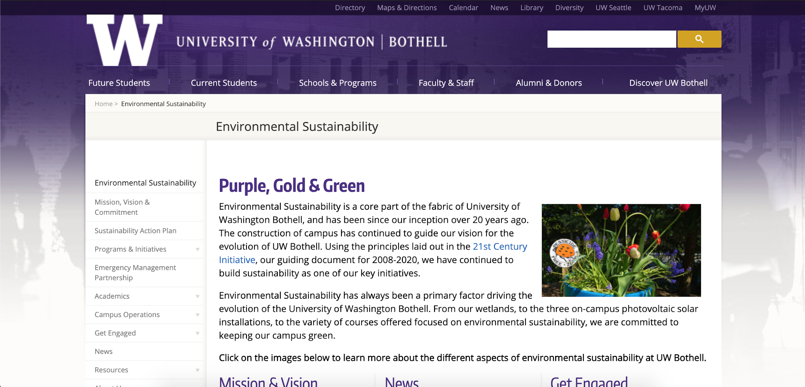
Design Idea 1:
Site Improvements
Use the knowledge we’ve gained through research to make logical organization/content updates and improve usability.
Place your screenshot here
https://docs.google.com/document/d/1hCWIHu6BKgTTZYCX9_Jg017QC5waFWV-QxWa7qX0lf4/edit?usp=sharing

Slide 23
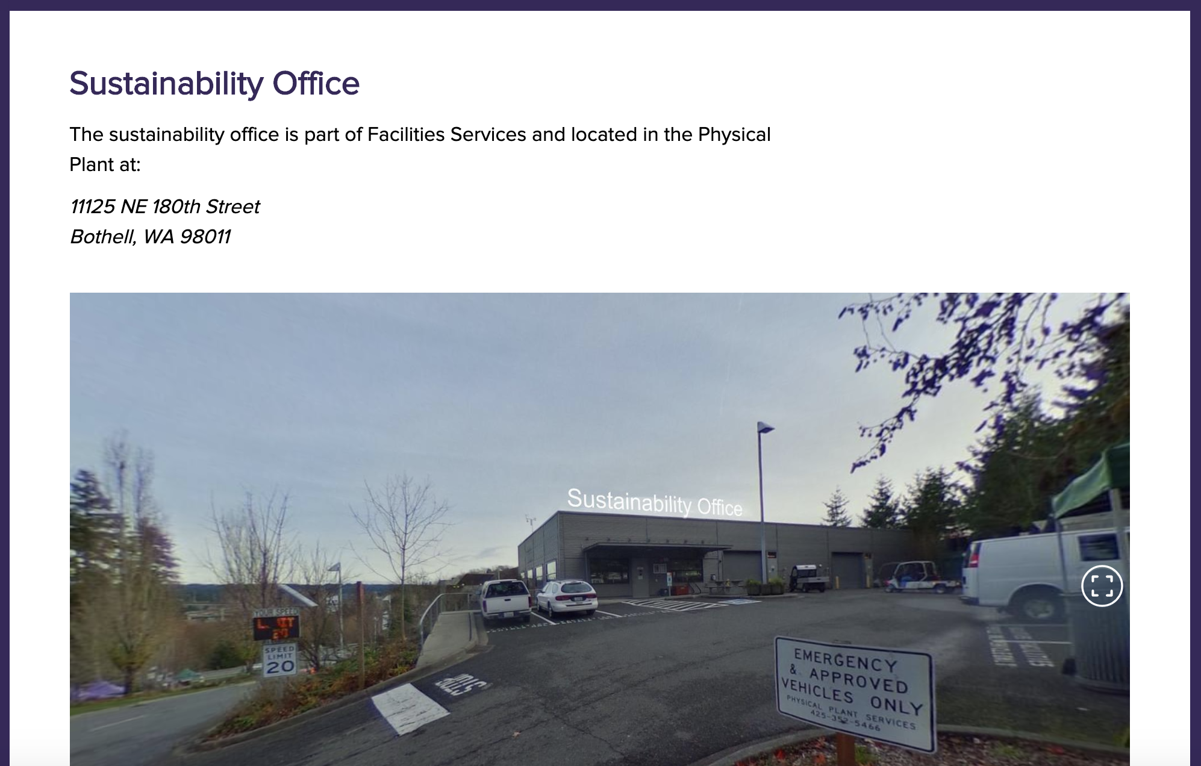
Design Idea 2:
360-Degree Photos
Implement 360-degree photos with site pages to give visitors a more immersive experience.
Place your screenshot here
https://davidhudson42.wixsite.com/sustainabilitymockup

Slide 24
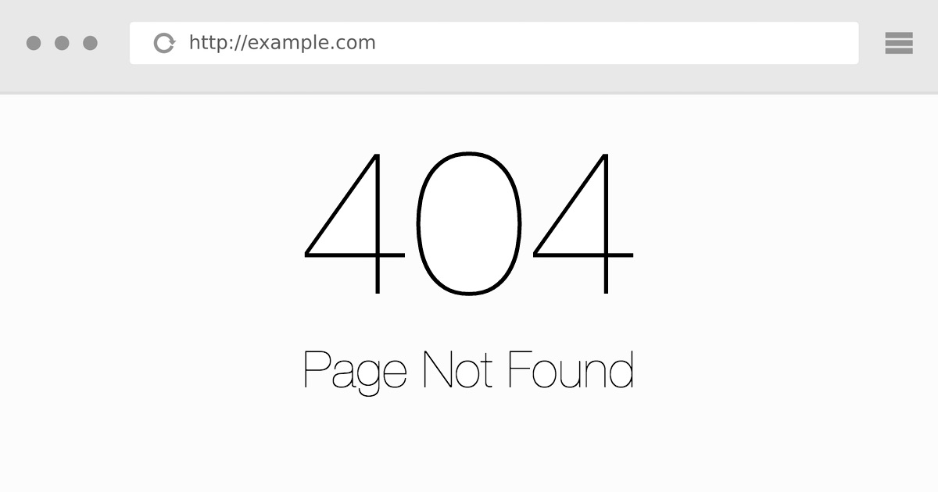
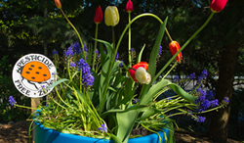
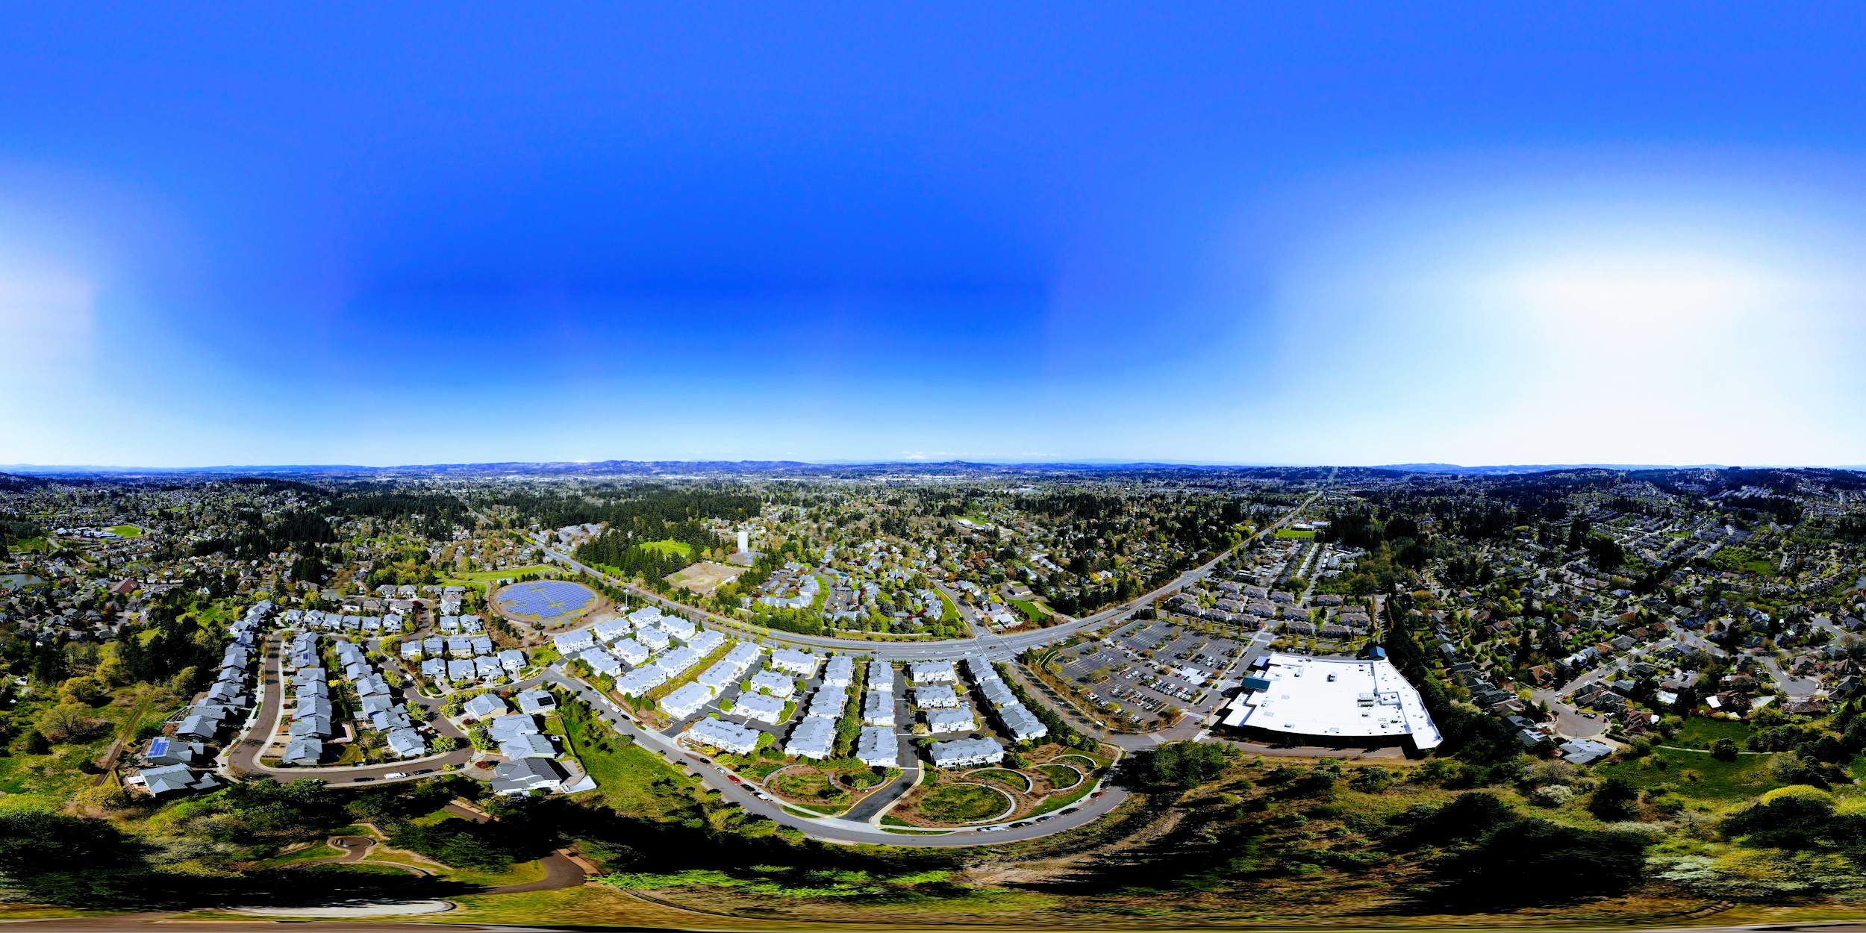

Next Steps
Quick changes
Broken links
Outdated info
Larger content changes
Combining pages
Adding content
360 photos
For pages that represent on-campus locations
Can replace or supplement existing photos

Slide 25
Thanks!
Presentation template by SlidesCarnival

